Slide 1

Recipes Seeker
Social Computing
Prof. Philippe Cudré-Mourux
Gianluca Demartini
Simpal Kumar, Samaneh Soleimani, Valentina Coletti

Slide 2
Menu
Motivation and Idea
Our Proposal
Technologies
Project Pitch
Questions
Social Computing

Slide 3
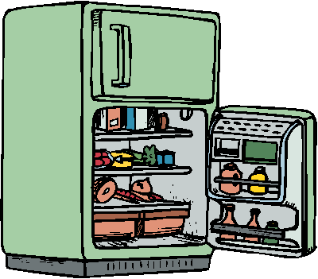

1. Motivation
Social Computing

Slide 4

Social Computing

Slide 5
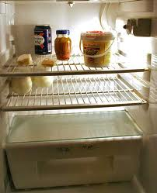
Social Computing

Slide 6
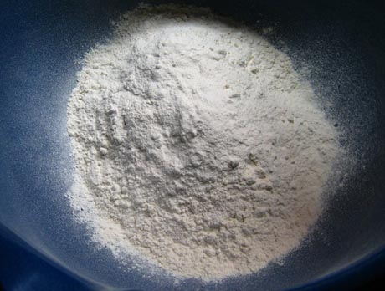
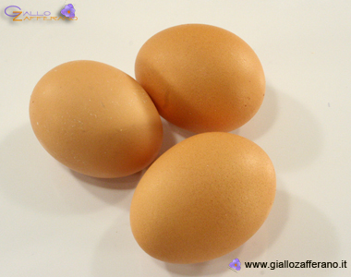
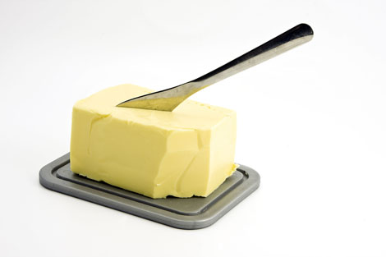

Social Computing

Slide 7

Social Computing

Slide 8

2. Idea
For people who:
  are always sick of seeking what to cook with what has left in the fridge?
  are looking for a new recipe with some certain ingredients or confused what can be done with available ingredients at home?
  have some ingredients left and don’t know what to cook with them?
Here it’s the solution!!
  www.RecipeSeeker.com
You can get recipes from all around the world; Thanks to crowdsourcing!! Or you could help others by providing your recipes and get awarded if rated nicely by users.
Social Computing

Slide 9
3. Proposal
Facebook Application: Recipes Seeker
Help the user with a user friendly interface
Input: user collect the ingredients in a basket
Output: list of recipes will appear, sort it by rating or relevance
Any user can add his/her own recipe and can view & rate all listed recipes on site.
Social Computing

Slide 10
3. Proposal
Crowdsourcing part:
  make life easier for the crowd to input new recipes
  Game
Funny quiz like :
"What can you prepare with : 3 boiled potatoes, sliced onions and 1 egg?”
Options from a database of existing suggestions with a free form to enter new ideas
Social Computing

Slide 11
4. Technologies
Play Framework
Java
Facebook &/or Twitter SDKs
MySQL
GitHub
Social Computing

Slide 12
4. Project Pitch
Discussed and mutually agreed on core issues like database structure, interface and constraints
Installed and configured the required tools and softwares
Setup repository in github
Setup milestones for next two months
Social Computing

Slide 13
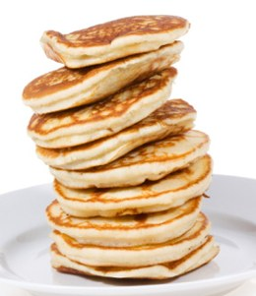
5. Questions
Thank you for your attention!
Do you have questions?
Do you have suggestion for a recipe with eggs, flour, milk and butter?
PANCAKES!!!!!
Social Computing

